Slide 1
AUTOMATED CLOTH CONFIGURATION SYSTEM
SUBMITTED BY:
Gurjyot kaur
95010
90370305159
Jasleen Kaur
95132
90370305174

Slide 2
About the Project
Project Name | Automated Cloth Configuration System
Company | ONE INFONET TECHNOLOGIES
Project Type | Desktop Application
Front End | Java ,swings, AWT.
Tool | NetBeans IDE 6.9.1

Slide 3
Module Details
The AUTOMATED CLOTH CONFIGURATION SYSTEM is a fully functional desktop application implemented in JAVA using SQL as a backend. It has two ends
Admin End: The admin is the owner of the system. He has access to prohibited sections of the system like “Add Item”, “Remove Item”, etc.
User End: The user is any ordinary customer who wishes to purchase tem from the store.

Slide 4
Module Details(Continued)
Login: To enter the system the user or admin have to enter their unique username and password assigned to them.
New user: When a new user wants to access the system, he is given a user form to fill. On submission of the credentials in the form his data goes to the database
Dynamic Selection: The user has to specify his colour and category specifications of the products he wishes to buy and the system produces a dynamic page according to his needs from which he can choose any item
Cart: After selecting the item and specifying his quantity the item is to be added to the cart. From this cart the user may delete or update his selection.
Billing: After the user has finalized his purchases, he has to get a bill of his items. The bill is generated dynamically as per the items in the cart. Each bill has a self-generated bill number which it gets from backend. The bill is first saved to the database and then a printout is taken.

Slide 5
Module Details(Continued)
Recent Purchases: In case the admin has logged in all the purchases made are available for viewing. Otherwise the user can view any purchases he has made in the past.
Add Item: This privilege is available only to the admin. In this the admin can select an image of item he wishes to add to his collection. Then he has to specify the category, cost and id of his item. Then dynamically two image files of size 70X70 px and 350X350 px are generated and saved in the project folder and the database.
Remove Item: This privilege is available only to the admin. In this the admin has to specify the product id of the item and the item is deleted from the database.

Slide 6
PROJECT IMPLEMENTATION
JAVA:-
The entire component has been developed using Java technology. Java has been chosen as the platform because of its feature rich nature. The Java Platform provides robust end-to-end solutions for networked applications as well as a trusted standard for embedded applications. So Java was a natural choice for development process.
Characteristics of Java:-
Object Oriented
Robust
Portable and Architecture-neutral (Platform Independent)
Multithreaded
Distributed
Secure
Dynamic and Extensible
High Performance
Compilation and Interpretation

Slide 7
PROJECT IMPLEMENTATION
JAVA SWINGS
"Swing" refers to the new library of GUI controls (buttons, sliders, checkboxes, etc.) that replaces the somewhat weak and inflexible AWT controls.
Main New Features:
MVC: Model View Controller
Improved L& F(Look & Feel)
Light weight
More Variety Of controllers.
NETBEANS IDE
The NetBeans Platform is a reusable framework for simplifying the development of Java Swing desktop applications. The NetBeans IDE bundle for Java SE contains what is needed to start developing NetBeans plugins and NetBeans Platform based applications; no additional SDK is required.

Slide 8
PROJECT IMPLEMENTATION
JDBC
The JDBC is a set of the database access classes. The very term JDBC stands for “Java Database Connectivity”. JDBC technology is an API (Application Program Interface) that allows virtual access to any tabular data source from the Java programming language by means of some connecting software called Drivers. It provides cross-DBMS connectivity to a wide range of SQL databases.
SQL:-
SQL stands for Structured Query Language, better known as “sequel”. It is used for:
1. Querying a database by editing the SQL statements.
2. Querying a database within a program
3. Defining data organization.
4. Administrating data
5. Accessing multiple data servers
6. Managing transaction.

Slide 9
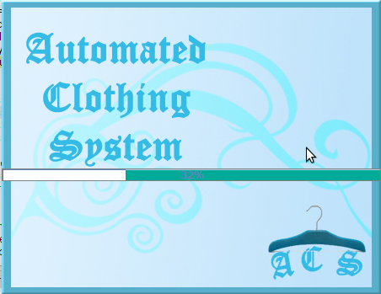
PROGRESS BAR
This is the first screen of the application

Slide 10
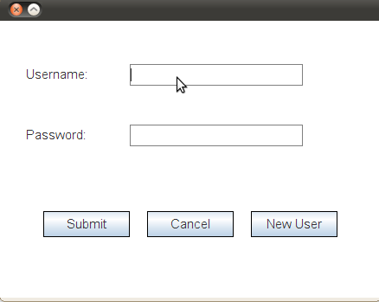
LOGIN FORM
Every user has to enter the unique allocated username password to enter the screen. New users can enter the system by clicking on new user button

Slide 11
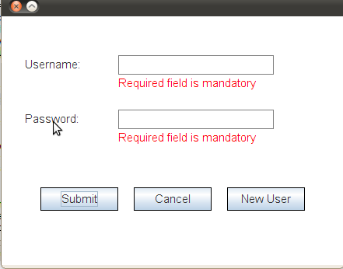
VALIDATIONS
Both username and password are mandatory fields.
If any of the required field is skipped an error message appears on the screen.

Slide 12
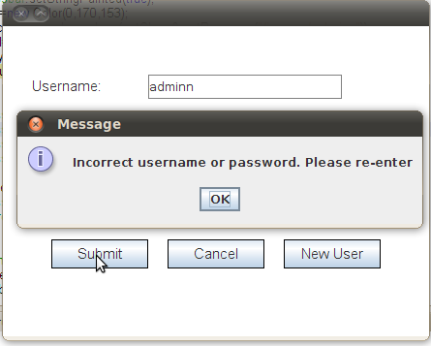
PASSWORD VALIDATION
The user name and password entered by the user is validated from the database. In case of an error an error message appears on the screen as above

Slide 13
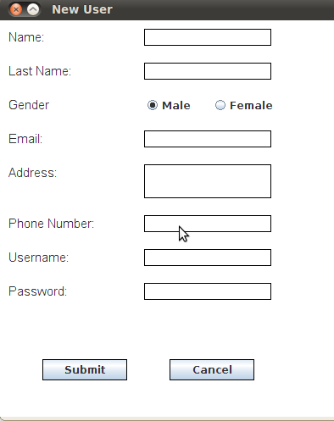
NEW USER
Every new user has to fill the a form to enter the system.

Slide 14
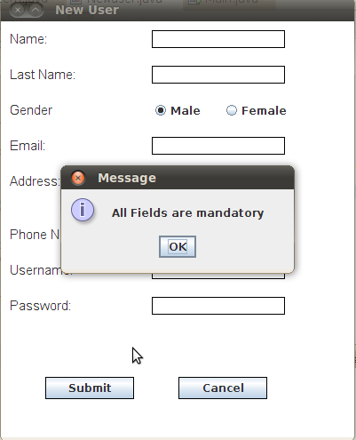
Validations
Each field in the form are mandatory. Every user should have a unique username. So in case a username is already allotted then an error message appears

Slide 15
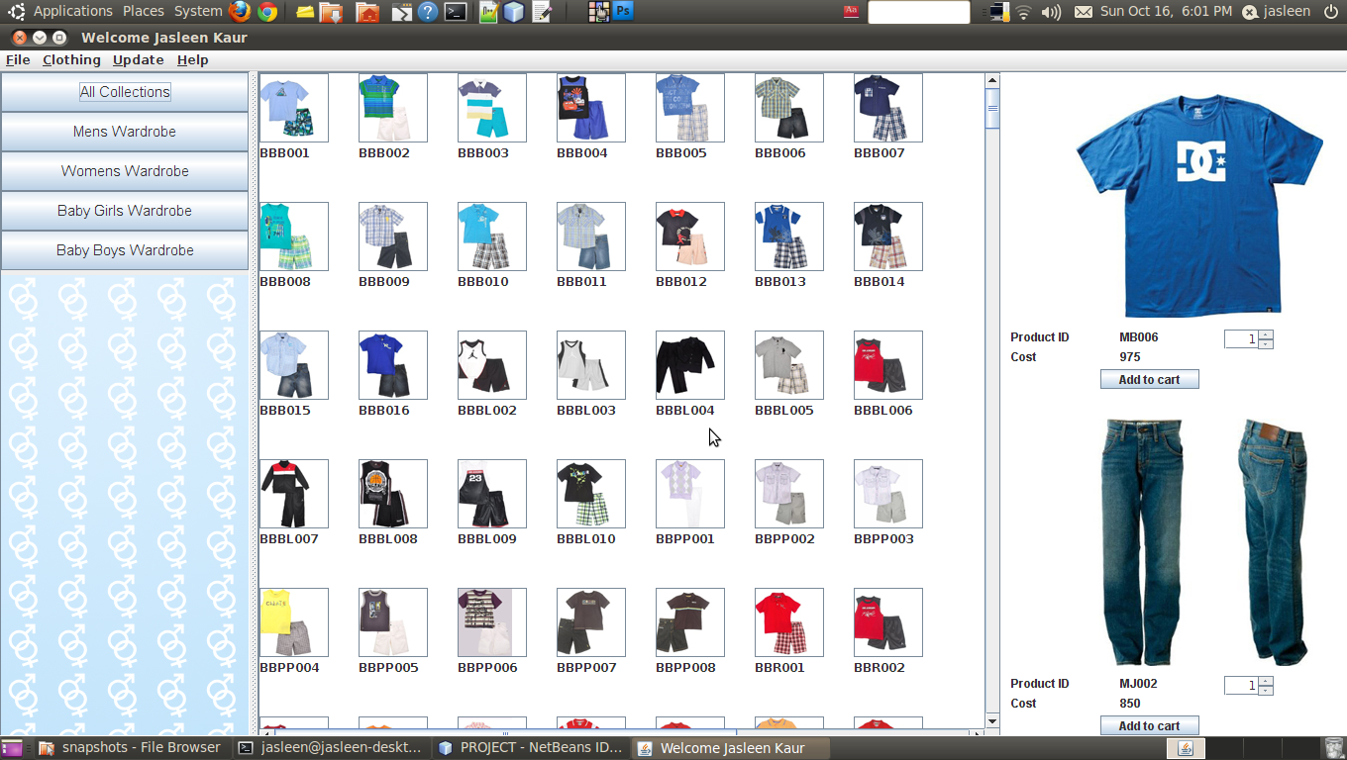
MAIN SCREEN
This is the main screen of the application

Slide 16
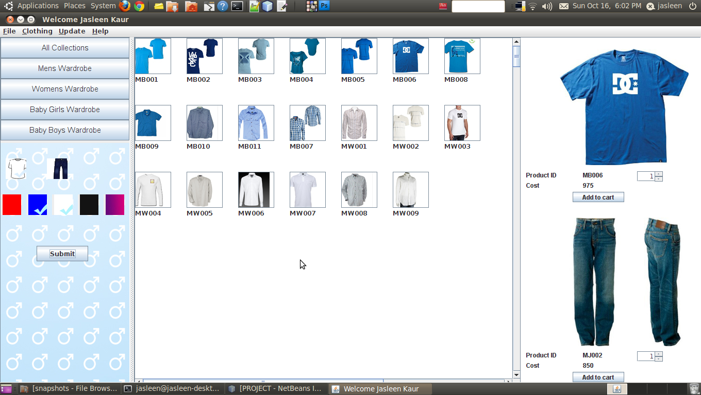
DYNAMIC PANELS
Five collections:- All, Men, women, baby girl and baby boy
Two Garment types: Upper and Lower
Five Colour Choices
The Jean section appears at the bottom so that the user can match his uppers and lowers
Dynamic page showing Mens Collection with uppers in blue and white colour
The user is given a choice of five collections, two garment types and five colours. The user selects his need and according to that a panel is dynamically created.

Slide 17
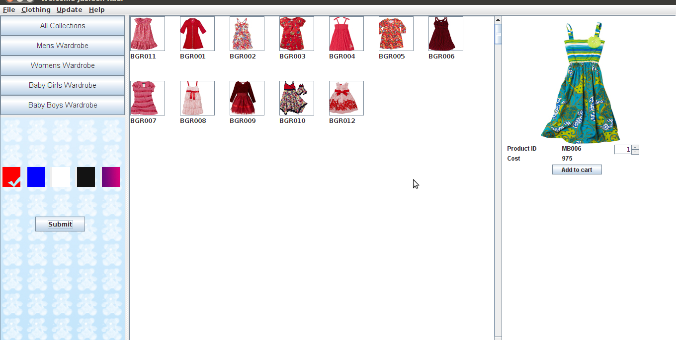
BABY COLLECTION
Here only colour choice no garment choice.
The baby collection deals in only one type of clothing garment.

Slide 18
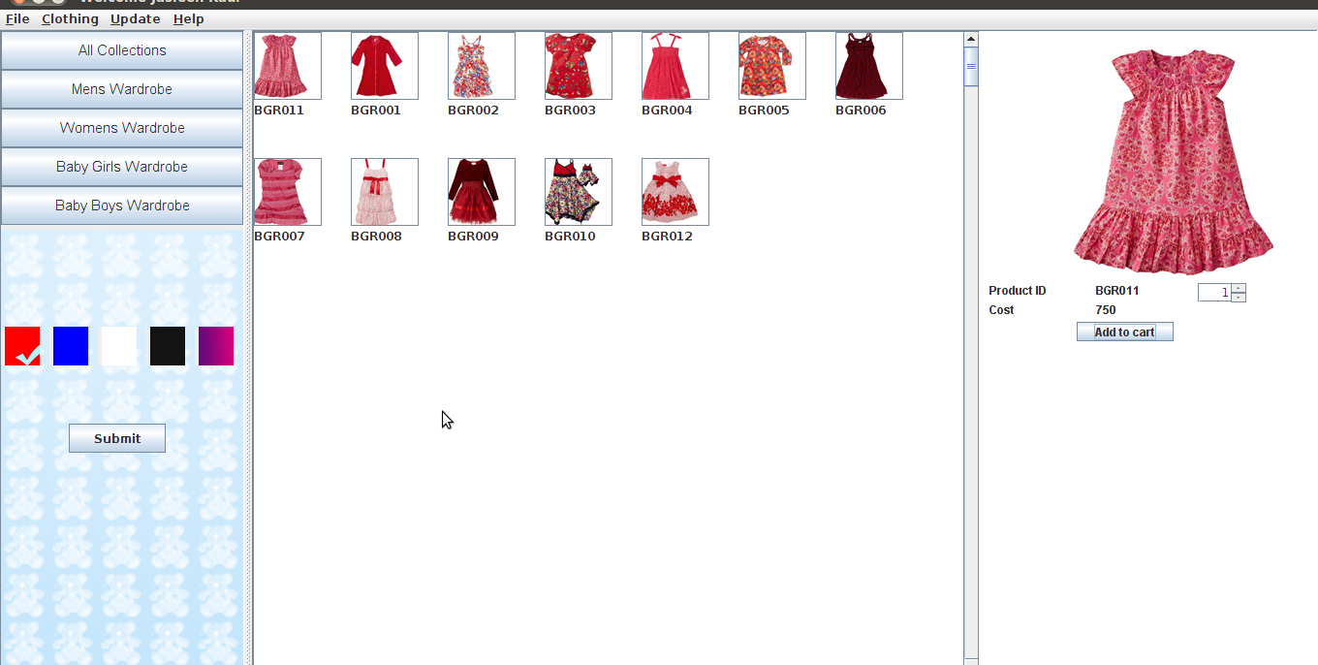
THE SELECTION PROCESS
The user can select item from the dynamically generated panel. The products’ ID, cost will appear along with an enlarged view

Slide 19
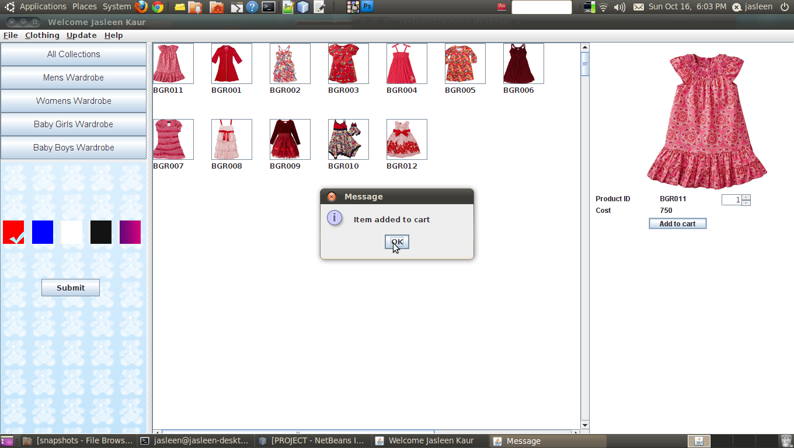
THE SELECTION PROCESS
To add your item to your cart. Select the quantity from the Jspinner and click on add to cart.

Slide 20
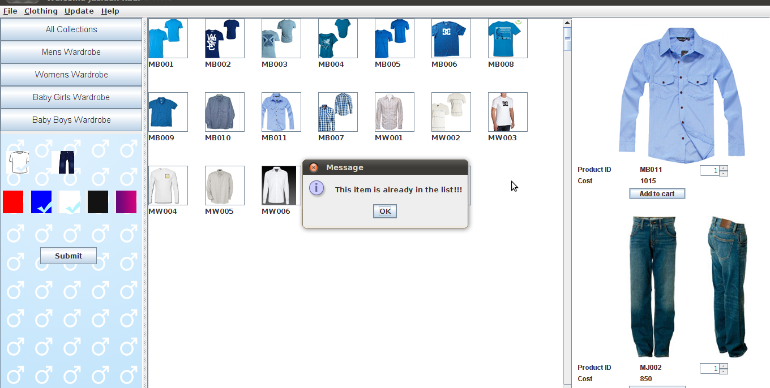
THE SELECTION PROCESS
To avoid duplication in the cart and bill an error message is shown which tells the item you are trying to add is already in the cart.

Slide 21
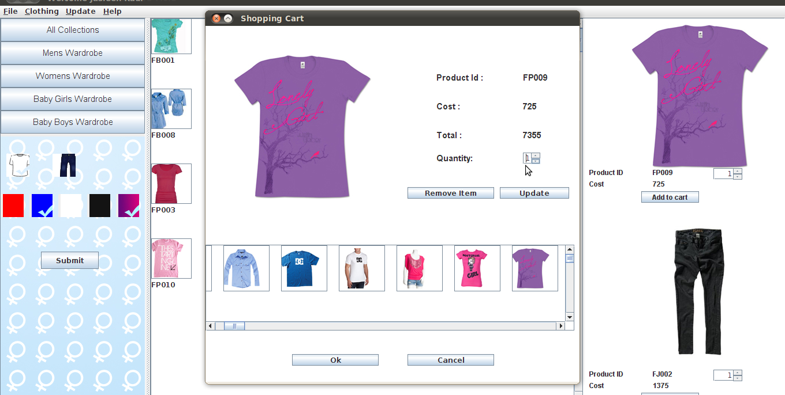
Shopping cart
The shopping cart has all the items selected by the user. The user can review his selected items by clicking on their icons in the scrollpane.

Slide 22
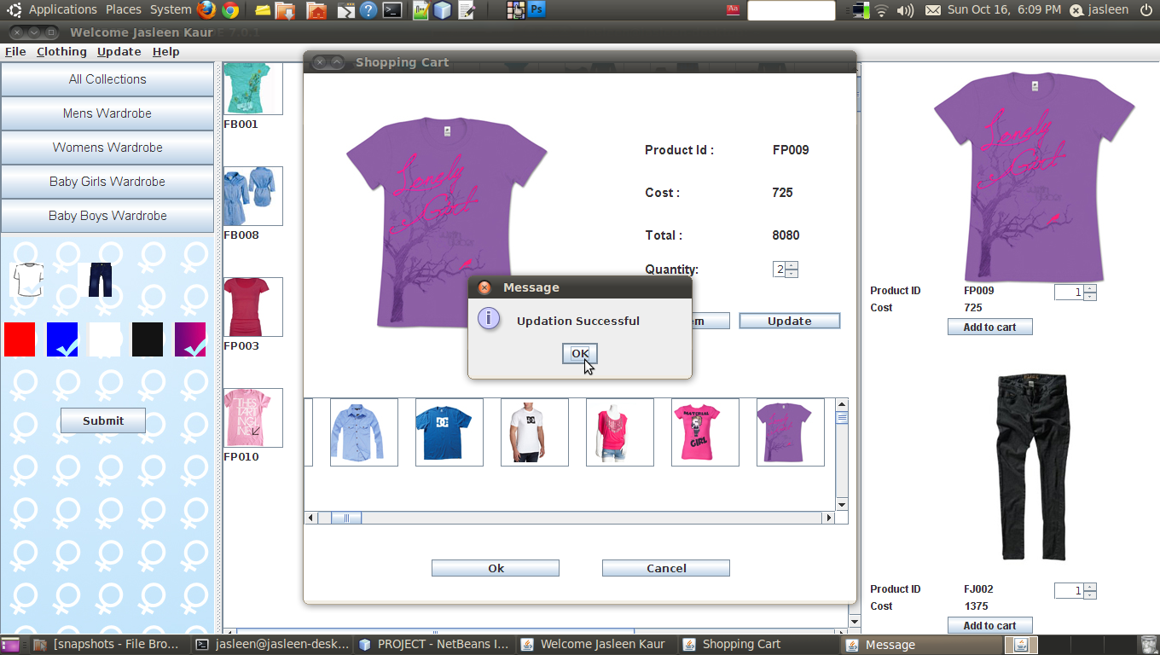
Shopping cart
The user can update the quantity from the JSpinner and click on the Update button.

Slide 23
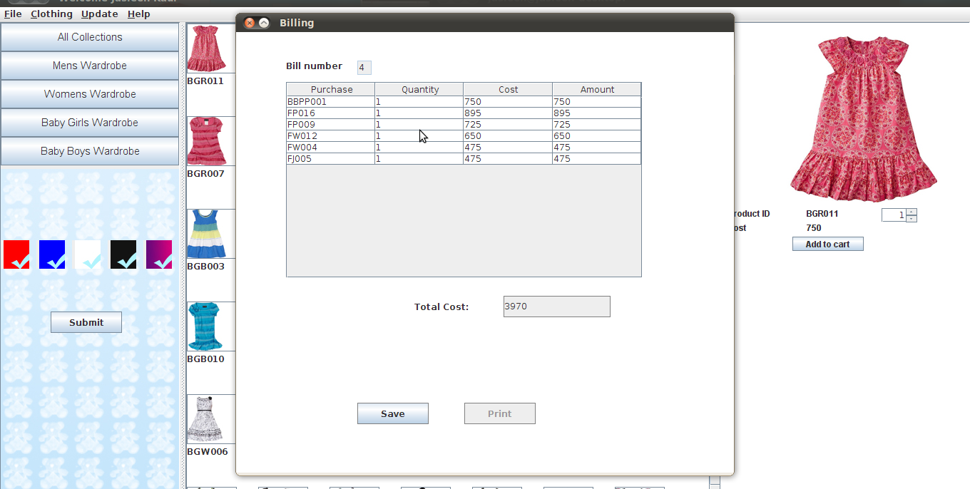
Billing
Unique bill number generated from the backend
The bill is automatically generated on the basis of the items added to the cart. Each bill is assigned a unique self-generated bill number from the backend.

Slide 24
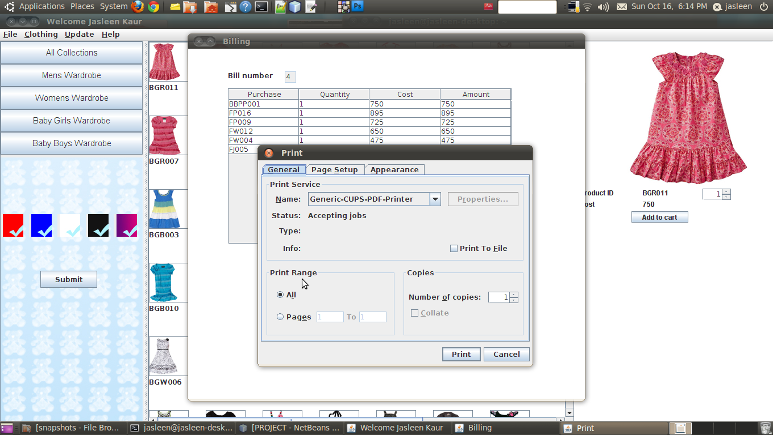
Billing
The bill can also be printed after saving to the database from the print button.

Slide 25
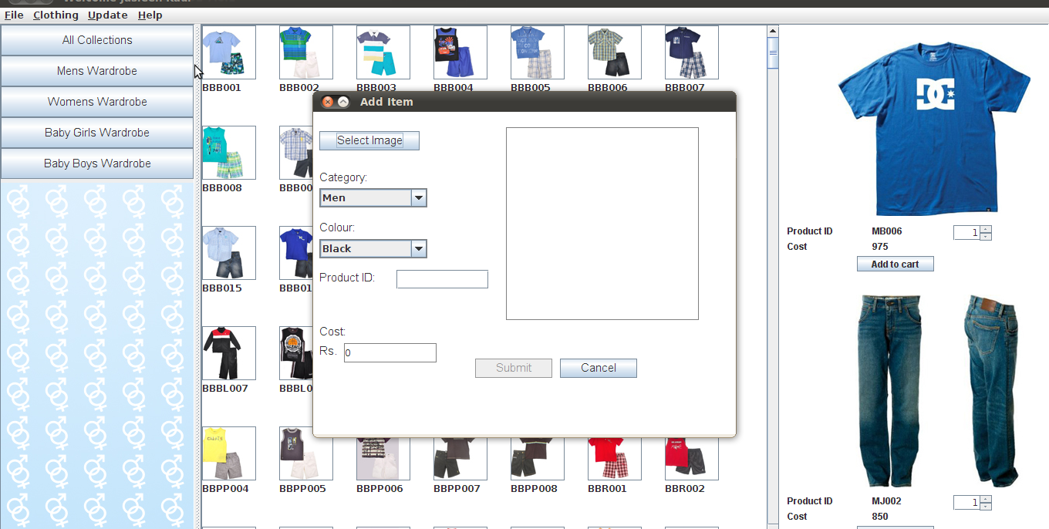
Add Item
This privilege is given to the admin only.

Slide 26
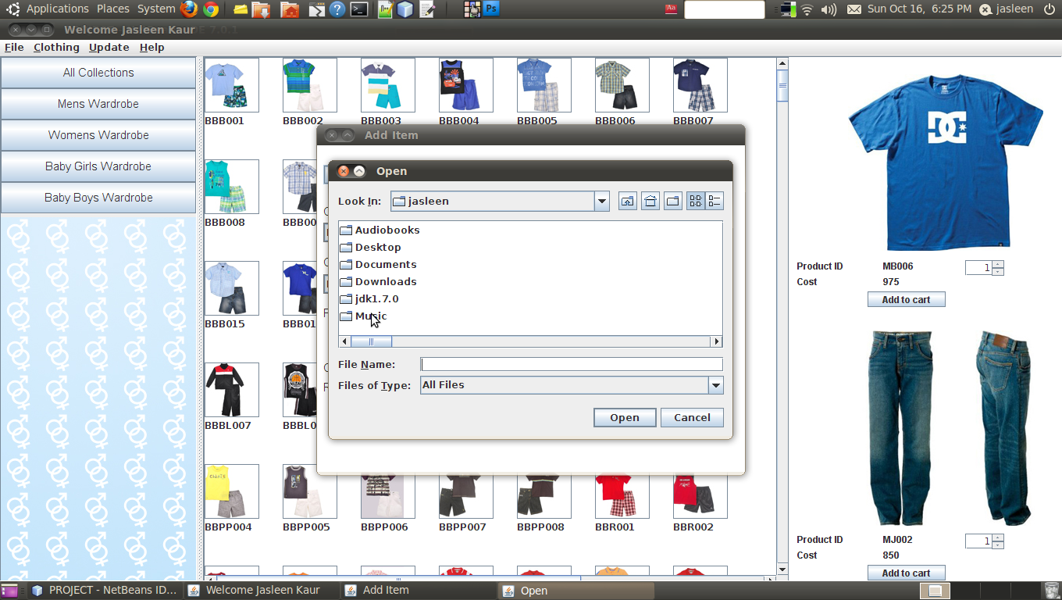
Add Item
To add an item the admin has to click on select image button which will open a Jopen Dialog Box from which he can select the image.

Slide 27
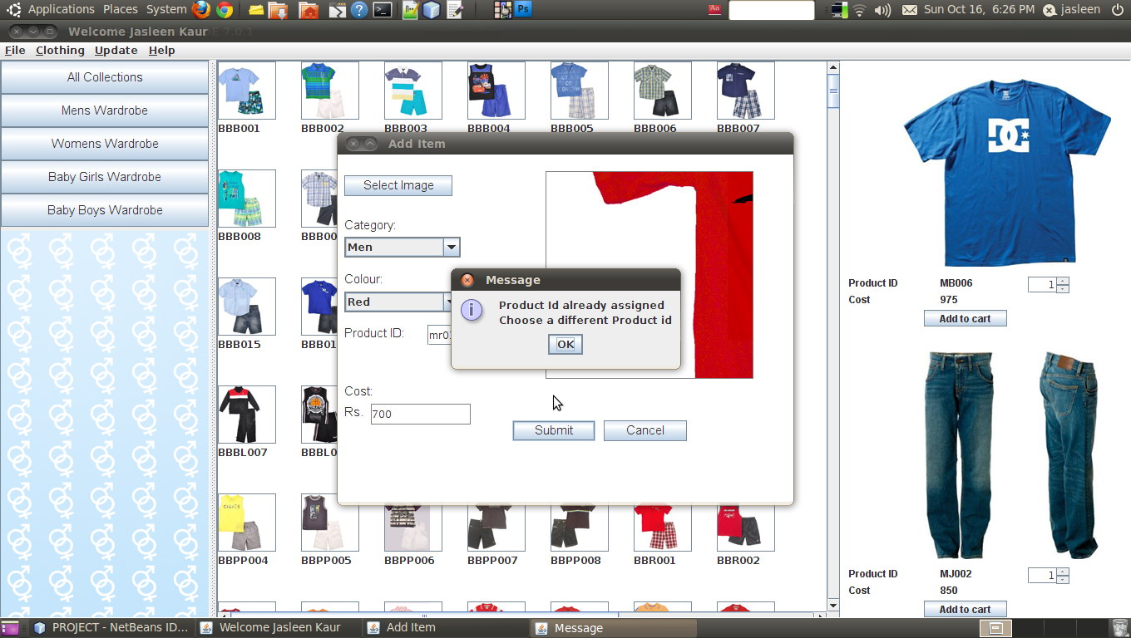
Add Item
After selecting the image the admin has to enter the Product Id and cost which he wishes to a lot to the item. As the product id is to be unique so a duplicate product id gives an error.

Slide 28

Add Item
On submission the item is added to the database and 2 image files of size 70X70 and 350X350 pixels are dynamically created in the source folder.

Slide 29
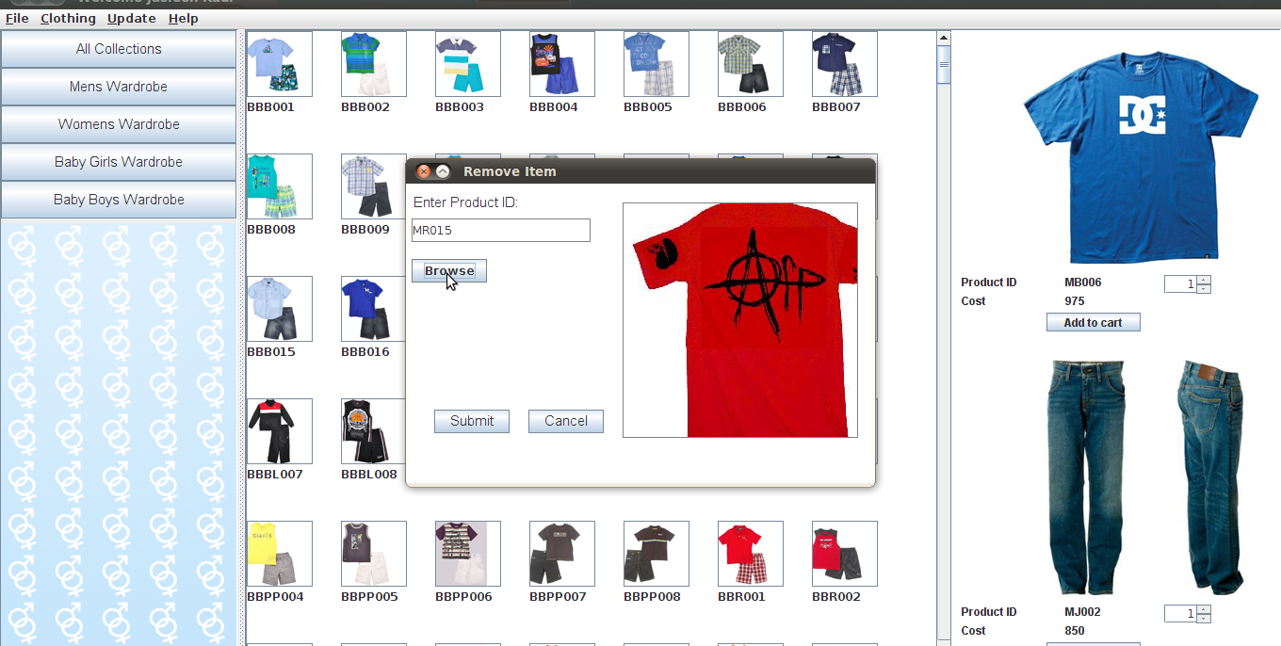
REMOVE ITEM
This privilege is given to admin only. The admin has to enter the product id and click on browse. Its preview will appear on the right hand side.

Slide 30
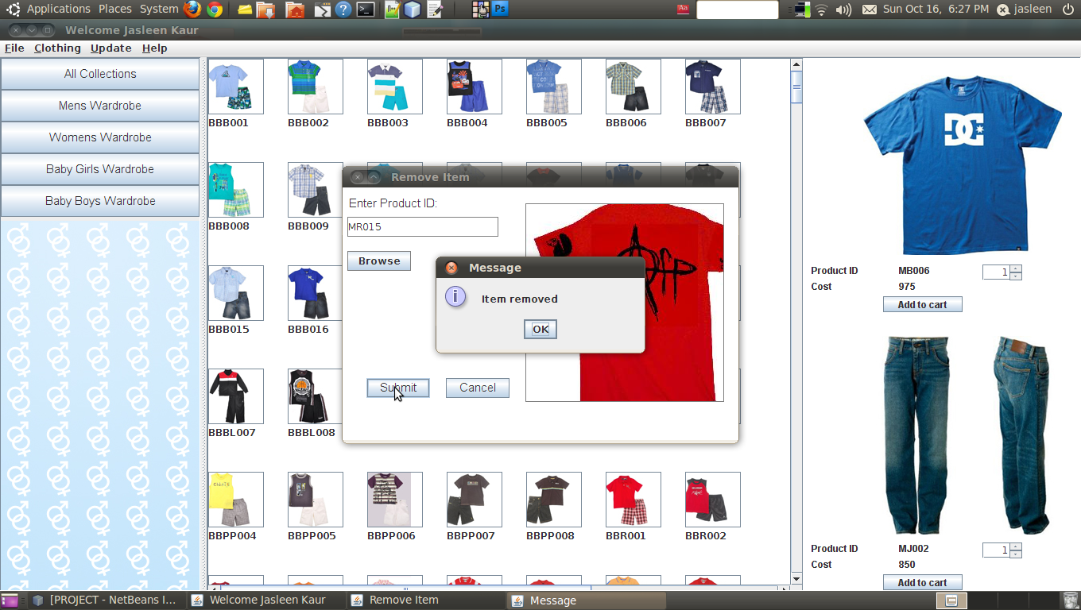
REMOVE ITEM
On clicking submit the item is removed from the database.

Slide 31
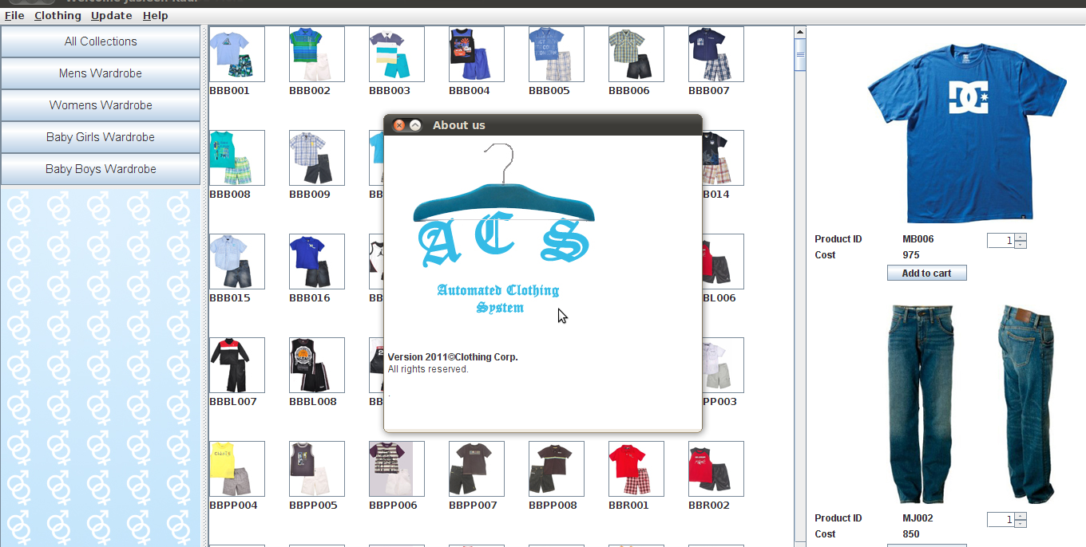
About us
The about us dialog box shows the company information along with its logo.

Slide 32
THANK YOU

